Slide 1
Urban Teacher Fellowship
Presented By:
Dr. Marini Smith, Program Coordinator

Slide 2
What is UTF?
The goal of the Urban Teacher Fellowship (UTF) is to prepare youth and adults from low-income communities for employment in the afterschool workforce, and create career pathways leading to teaching careers in Los Angeles County.
The program begins by training participants to work in afterschool programs, using this employment as a source of financial support and as a career-linked learning lab for participants as they move through a multi-year sequence from Associate's to Bachelor's degrees and ultimately to a teaching credential.

Slide 3
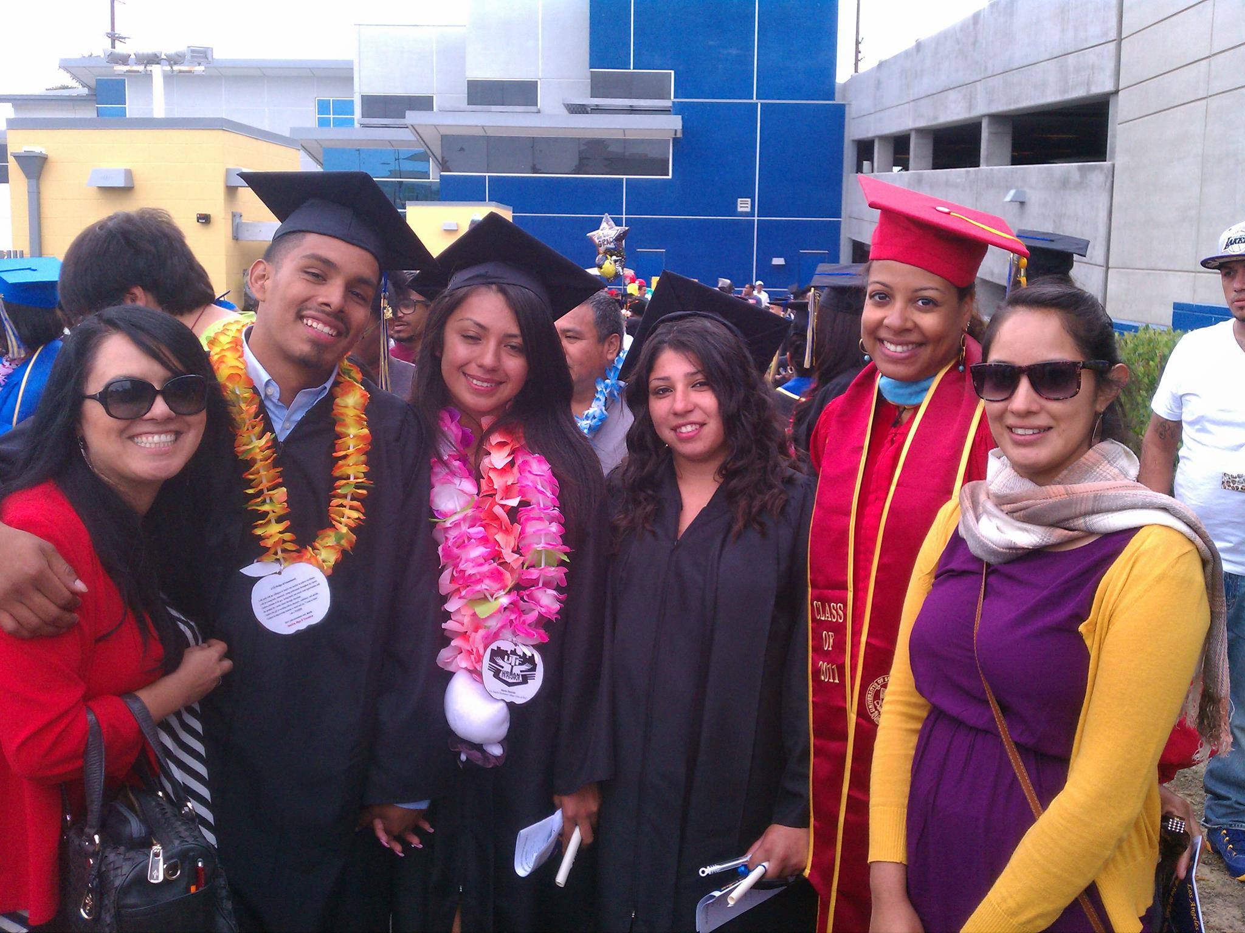
UTF Benefits
Cohort Model
Student Support Specialist
Academic Workshops
Professional Development Workshops
Student Organization (SCTA)
Transportation Benefits
CBEST Preparation
A.A. Degree
Assist in Transfer

Slide 4
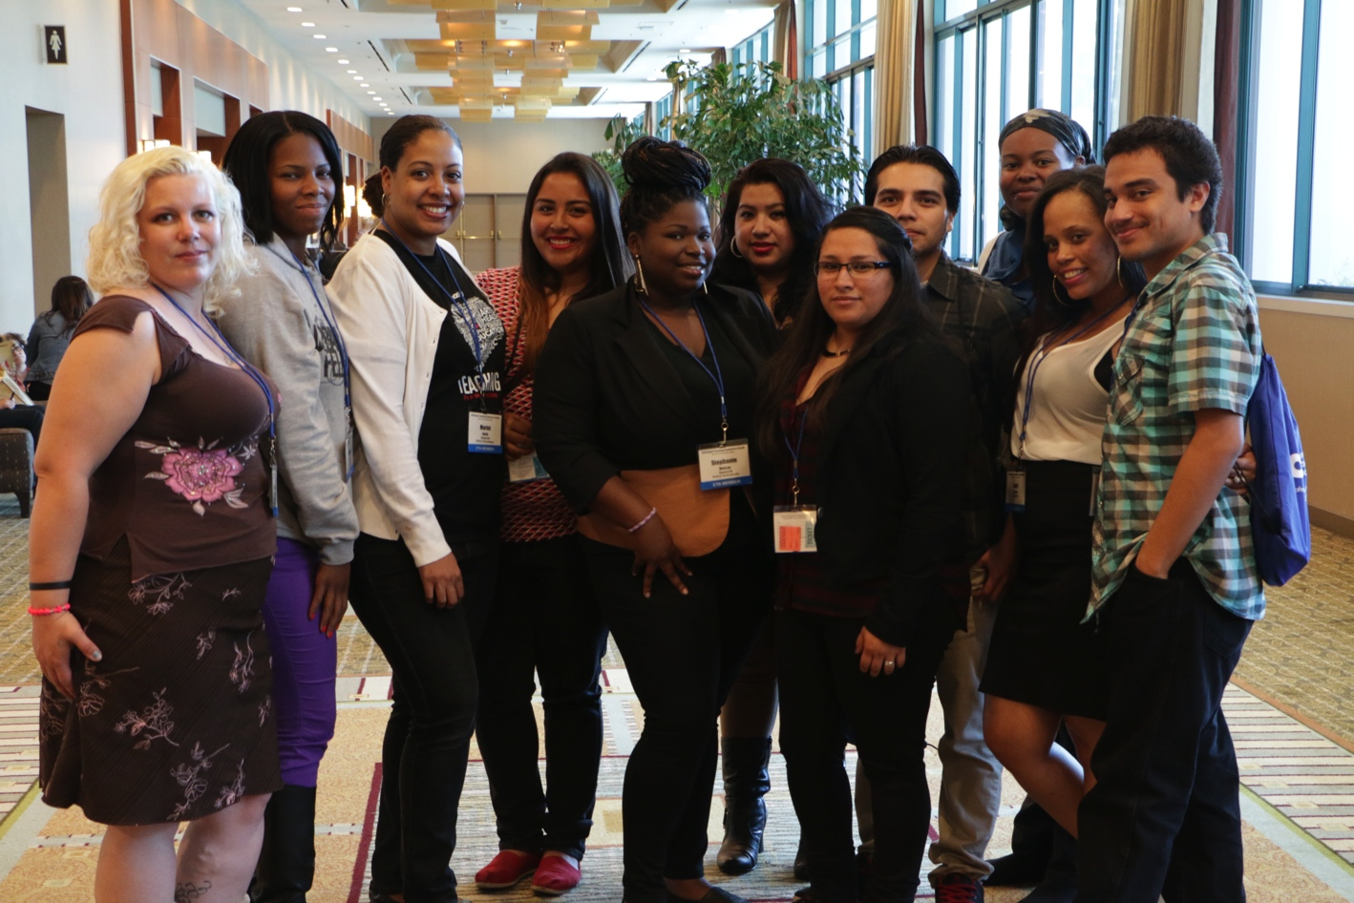
UTF Workshops
Time management
Stress Reliever
Learning Styles
CBEST Preparation
Emotional / Mental Health
Financial Aid
Student Input is important.

Slide 5
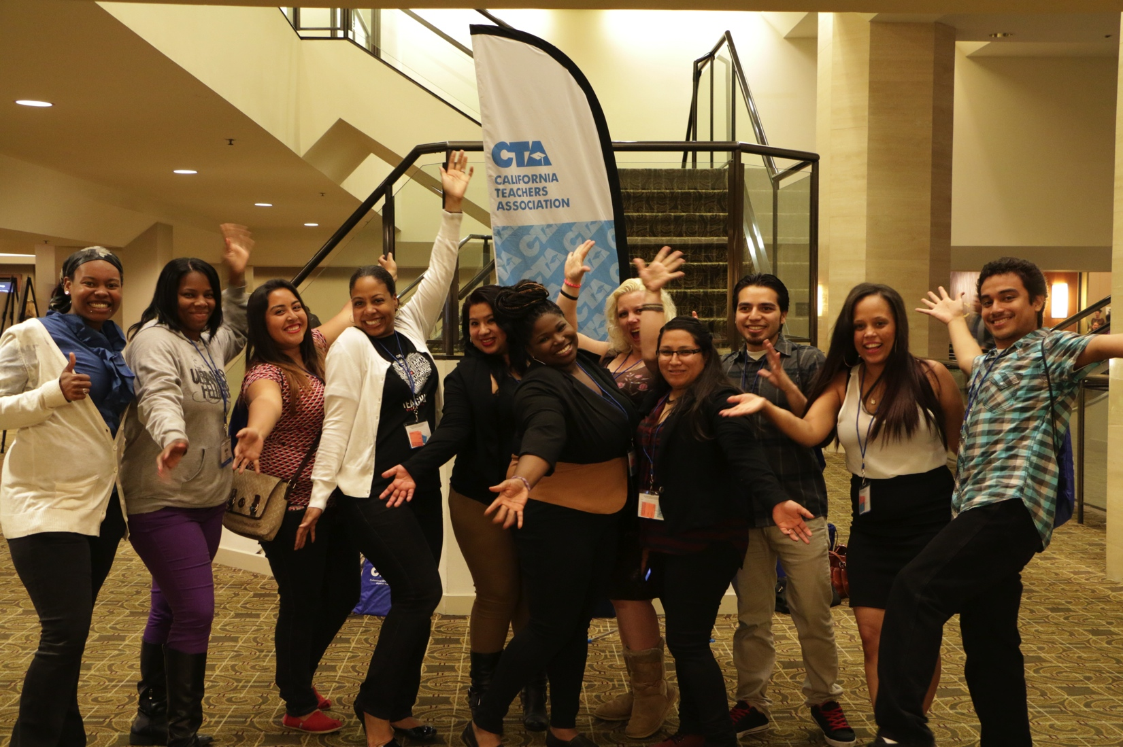
Student California Teacher Association
Student CTA strives to be a recognized and collaborative organization that inspires and fosters exemplary future leaders in education.
SCTA in LASC is student run and lead.
Students hold leadership positions and assist with icebreakers during workshops.
Organize events on campus.
Attend annual conference and network.

Slide 6
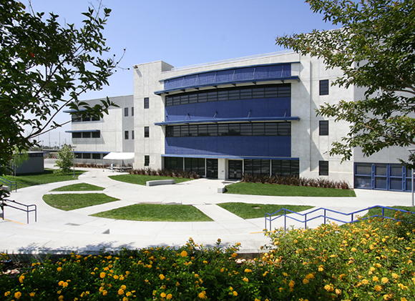
Los Angeles Southwest College
Education Opportunity Program/S
General Academic Counseling
First Year Experience (FYE)
Men’s Initiative
Financial Aid
Health Center
Student Success Center
Math Lab
English Lab

Slide 7
UTF Partners
The program includes participation by four pairs of Los Angeles County community colleges, CSU’s.
Support from LAUSD and most major area school districts and afterschool employers.
Recognized for its potential as a model to address the looming teacher shortage in California, UTF’s model has served as the major source of inspiration for the statewide California Teacher Pathway strategy.

Slide 8
California Teacher Pathway
The California Teacher Pathway’s (CTP) mission is to cultivate a systemic, publicly-funded pathway that will create a local, diverse, and experienced corps of “homegrown” teachers who are more reflective of the diversity within California’s communities and committed to teaching in the communities in which they have lived and worked.

Slide 9
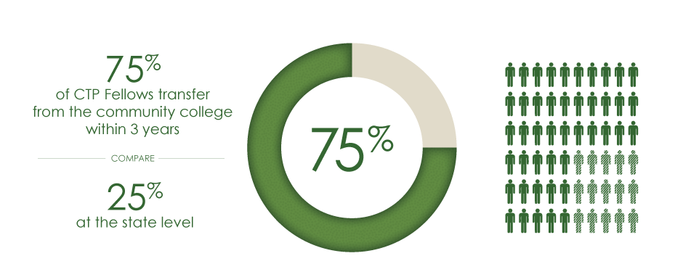
CTP Thriving
The CA Teacher Pathway (CTP) wants to inspire young people to become teachers and create leaders in the community.
We currently have over 700 CTP Fellows in the pipeline at various points in their educational career.
Notes:
Generally, we’re seeing about 75% of CTP Fellows complete community college and transfer to a CSU within 3 years compared to the state’s average at about 24%.
From our original pilot group of students who began their community college education in 2008, we have 7 teachers already in the classroom with six of them teaching math and one teaching science. Each semester, more students will complete their teaching credential, BA degree, AA degree or transfer to a California State University.

Slide 10
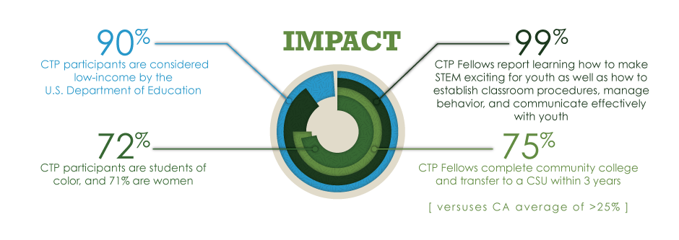
Our Impact

Slide 11
UTF Video
http://youtu.be/05cS2ZOPWVc

Slide 12
Join UTF @ LASC !
Thank you for your time.
Any questions?

